Slide 1

Xinge Rao: Supervisor Meeting 3
Wed 22 July 2026 12:00 - Rankine

Slide 2
Causal Inference for Robotic Grasp Failure Diagnosis under Perceptual Degradation
Phase 1
Phase 2
Phase 3
Phase 4
Simulation Pipeline
Data Collection
Structural Causal Model
LLM Baseline
COMPLETE
COMPLETE
In progress
UPCOMING
MuJoCo scene • Contact-GraspNet IK controller • 432-trial experiment
Factorial grid (4×4×3×3×3) 432 trials • CSV logged
Fit SCM on collected data Counterfactual diagnosis
Zero-shot GPT-4o prompting Comparison with SCM accuracy

Slide 3
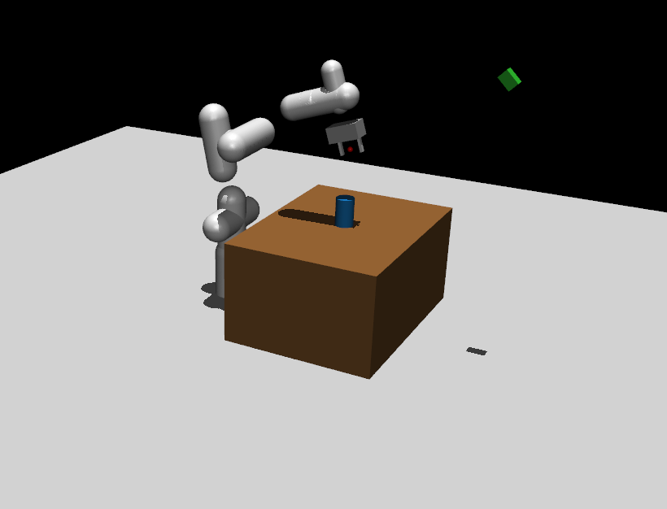
Scene in Mujoco

Slide 4
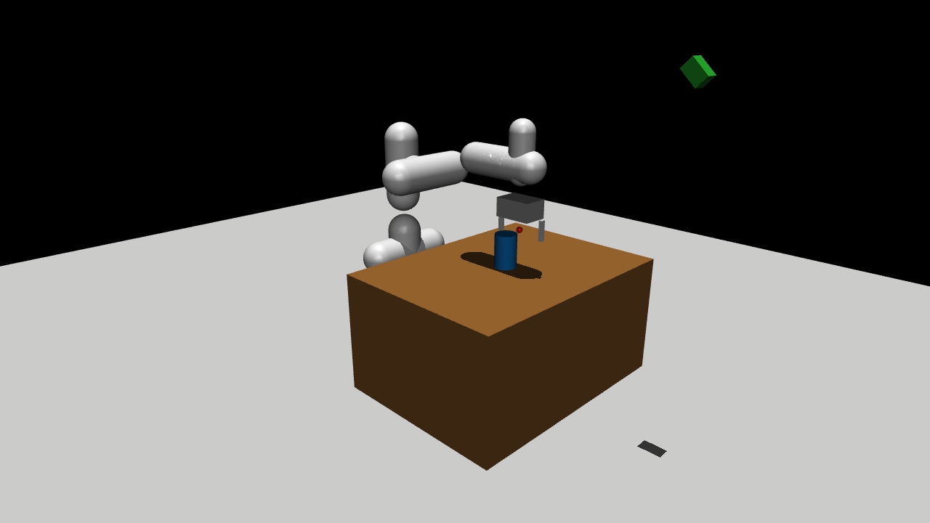
GRASP demo

Slide 5
Results:

Slide 6




Thank You!
#UofGWorldChangers
@UofGlasgow

